Slide 1

DEVELOPMENT GUIDE
Nam Ha Minh
Project: Inventory

Slide 2
1. Install Development Tools
Java: JDK 8:
http://www.oracle.com/technetwork/java/javase/downloads/index.html
IDE: Eclipse Neon (4.6) for Java EE Developers
http://www.eclipse.org/downloads
Database:
MySQL Community Server:
https://dev.mysql.com/downloads/mysql/
MySQL Workbench:
https://dev.mysql.com/downloads/workbench/

Slide 3
2. Design Database
Table Category:
category_id: primary key, integer, auto-increment, not null
name: varchar(64), not null
Table Product:
product_id: primary key, integer, auto-increment, not null
category_id: foreign key, integer, not null
name: varchar(128)
description: varchar(1024)
price: float

Slide 4
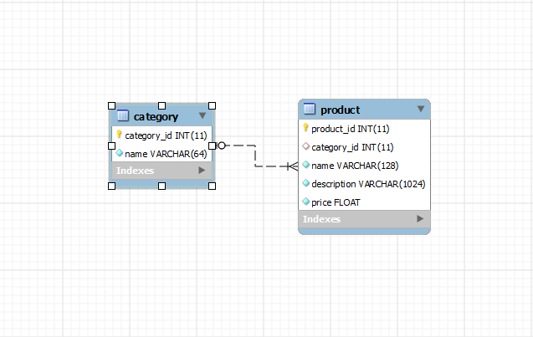
2. Design Database – ER DIAGRAM

Slide 5
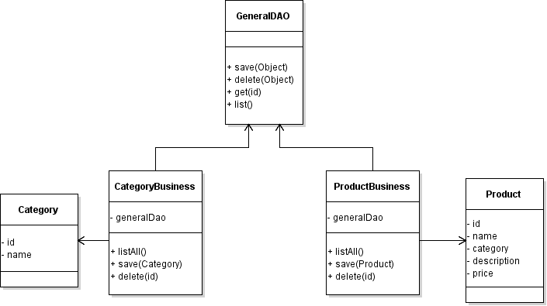
3. DESIGN CLASS DIAGRAMS
Classes in DAO & Business Layers:

Slide 6
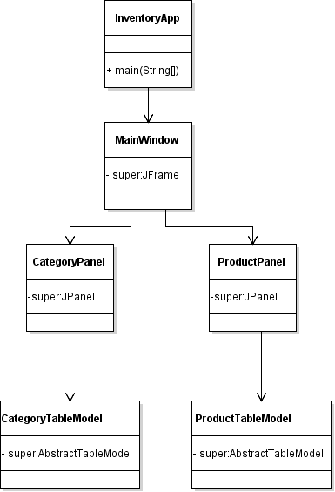
3. DESIGN CLASS DIAGRAMS
Classes in GUI Layer:

Slide 7
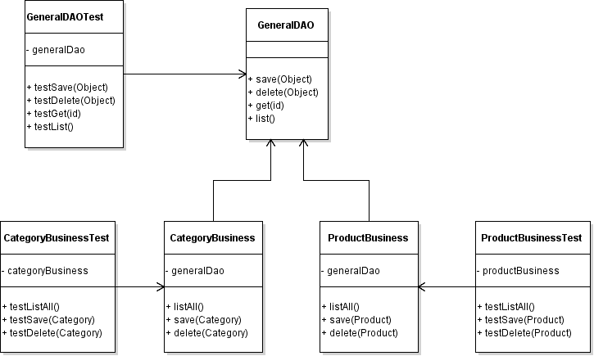
DESIGN CLASS DIAGRAMS
Unit Test Classes for DAO & Business Layer:

Slide 8
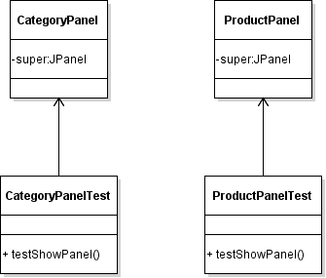
DESIGN CLASS DIAGRAMS
Unit Test Classes for GUI Layer:

Slide 9
4. Setup Project in Eclipse
Create a Maven Project: Inventory
Maven Artifact:
Group Id: com.inventory
Artifact Id: Inventory
Package type: JAR
Name: Inventory Management
Description: Manage categories and products in an inventory
Add Dependencies for:
Hibernate Core (ORM)
MySQL Connector Java (JDBC Driver)
Create Java Packages:
com.inventory.dao
com.inventory.business
com.inventory.gui

Slide 10
5. Code GeneralDao class
Create Hibernate Configuration File (hibernate.cfg.xml):
Code GeneralDAO class:
connect(): connects to the database and loads a Session.
close(): closes the session and terminates connection to the database.
save(Object): persists a mapped object as a row to database
list(Class type): returns all rows in a table as a collection of mapped objects
delete(Object): removes a row that maps to the specified object
get(Class type, id): retrieves a row as a mapped object

Slide 11
5. Code GeneralDaoTest class
Code GeneralDAOTest class:
Implement setUp()
Implement tearDown()
Write test method: testSave()
Write test method: testList()
Write test method: testDelete()
Write test method: testGet()

Slide 12
6. Code Entity Classes
Code Category Class:
Fields: id, name
Constructors
Getters & Setters
Annotations: @Entity, @Table, @Id, @Column…
One to Many Mapping: @OneToMany
Code Product Class:
Fields: id, name, category, description, price
Constructors
Getters & Setters
Annotations: @Entity, @Table, @Id, @Column
Many to One Mapping: @ManyToOne, @JoinColumn

Slide 13
7. Code Business Classes & Unit Tests
CategoryBusiness:
listAll(): returns all categories
save(Category): saves a category
delete(Category): deletes a category
CategoryBusinessTest:
testListAll()
testSave()
testDelete()
ProductBusiness:
listAll(): returns all categories
save(Product): saves a product
delete(Product): deletes a product
ProductBusinessTest:
testListAll()
testSave()
testDelete()

Slide 14
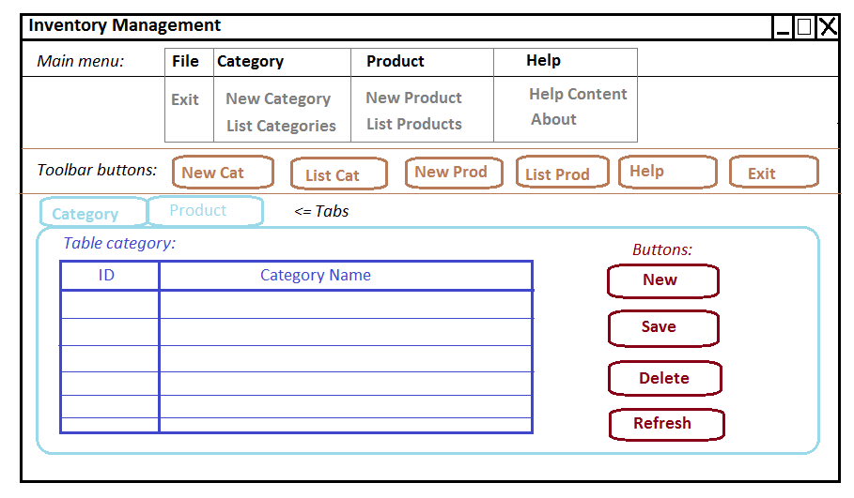
8. Code User Interface Layer

Slide 15
8. Code GUI – Category panel
Write CategoryTableModel
Create JTable with dummy data
Create JButtons
Layout manager: GridBagLayout
Handling events for JButtons
Write CategoryPanelTest class

Slide 16
GUI - DESIGN CLASS DIAGRAMS
Classes in GUI Layer:

Slide 17
Unit Tests for GUI Classes
Unit Test Classes for GUI Layer:

Slide 18
8. Code GUI – Main Window
MainWindow (JFrame):
Containers: JFrame, JPanel, JTabbedPane
Layout Manager: GridBagLayout
Menu items: JMenuBar, JMenu, JMenuItem
Toolbar buttons: JToolbar, JButton
Tabbed pane contains CategoryPanel and ProductPanel
InventoryApp: Launches the MainWindow
Handling Events for menu items and toolbar buttons

Slide 19
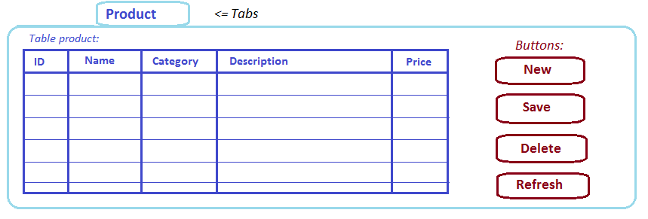
GUI DESIGN – PRODUCT TAB

Slide 20
8. Code GUI – Product Panel
Write ProductTableModel
Create JTable with dummy data
Create JButtons
Layout manager: GridBagLayout
Handling events for JButtons
Write ProductPanelTest class

Slide 21
9. Code Integration (BUSINESS & GUI)
Category Management:
Load Category Table in Category Panel (on startup)
Integrate List Categories function with menu item, toolbar button and Refresh button
Integrate New Category function with menu item, toolbar button and form button:
Enter category name from an input dialog
Integrate Delete Category function with form button:
Ask for confirmation in a dialog before deleting
Integrate Edit Category function with form button:
Edit category name from an input dialog

Slide 22
9. Code Integration (BUSINESS & GUI)
Product Management:
Load Product Table in Product Panel (on startup)
Integrate List Products function with menu item, toolbar button and Refresh button
Integrate New Product function with menu item, toolbar button and form button:
Show a new form (dialog) to enter the product information
Integrate Delete Product function with form button:
Ask for confirmation in a dialog before deleting
Integrate Edit Product function with form button:
Show an edit form (dialog) to edit the product information

Slide 23
9. Code Integration (continued)
Implement Help function:
Open a webpage
Implement About function:
Display a message dialog

Slide 24
9. Code Integration (continued)
Handling Exceptions for:
List categories
List products
Save category
Save product
Delete category
Delete product
Disconnect from database when the program exits

Slide 25
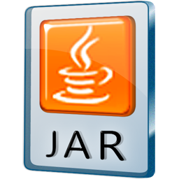
10. Package application
Package the application to an executable JAR file using Maven build
Test all the functionalities

Slide 26
Packing jar file with maven build
Add the following XML code to pom.xml file:
<plugins>
<plugin>
<artifactId>maven-assembly-plugin</artifactId>
<configuration>
<archive>
<manifest>
<mainClass>com.inventory.gui.InventoryApp</mainClass>
</manifest>
</archive>
<descriptorRefs>
<descriptorRef>jar-with-dependencies</descriptorRef>
</descriptorRefs>
</configuration>
</plugin>
</plugins>
Run As > Maven build… > Goals: assembly:single

